Slide 1
Relational Database

Slide 2
A relational database organizes data into rows and columns, which collectively form a table where the data points are related to each other.
Properties of a Relation:
Each relation has a unique name by which it is identified in the database.
Relation does not contain duplicate tuples.
The tuples of a relation have no specific order.
All attributes in a relation are atomic, i.e., each cell of a relation contains exactly one value.

Slide 3
What is an attribute?
A column is a vertical entity in the table which contains all information associated with a specific field in a table.
Properties of an Attribute:
Every attribute of a relation must have a name.
Null values are permitted for the attributes.
Default values can be specified for an attribute automatically inserted if no other value is specified for an attribute.
Attributes that uniquely identify each tuple of a relation are the primary key.

Slide 4
Domain:
For each attribute of a relation, there is a set of permitted values, called the domain of that attribute.
The domain refers to the possible values each attribute can contain. It can be specified using standard data types such as integers, floating numbers, etc.
NULL Values:
The null value is a special value that signifies that the value is unknown or does not exist.
The NULL value of the table specifies that the field has been left blank during record creation. It is different from the value filled with zero or a field that contains space.

Slide 5
Relation Schema
Relation schema defines the design and structure of the relation or table in the database.
It is the way of representation of relation states in such a way that every relation database state fulfills the integrity constraints set (Like Primary key, Foreign Key, Not null, Unique constraints) on a relational schema.
It consists of the relation name, set of attributes/field names/column names. Every attribute would have an associated domain.
Thus, in the relational model the term relation is used to refer to a table, while the term tuple is used to refer to a row. Similarly, the term attribute refers to a column of a table.
We use the term relation instance to refer to a specific instance of a relation, i.e., containing a specific set of rows.

Slide 6
Anomalies in DBMS
A database anomaly is an inconsistency in the data resulting from an operation like an update, insertion, or deletion. There can be inconsistencies when a record is held in multiple places and not all of the copies are updated.
Anomalies occur when the data present in the database has too much redundancy.
A database anomaly is a fault within a database, which can occur because of poor planning or when everything is stored in a flat database

Slide 7
Type of Anomalies in DBMS
There are different types of anomalies that can occur in a database.
Data anomalies can be broadly categorized into three types:
1. Insertion Anomalies
These occur when specific attributes cannot be inserted into the database without the presence of other attributes.
Example: In a student database, an insertion anomaly exists if a new student's details cannot be inserted without entering their course enrollment.

Slide 8
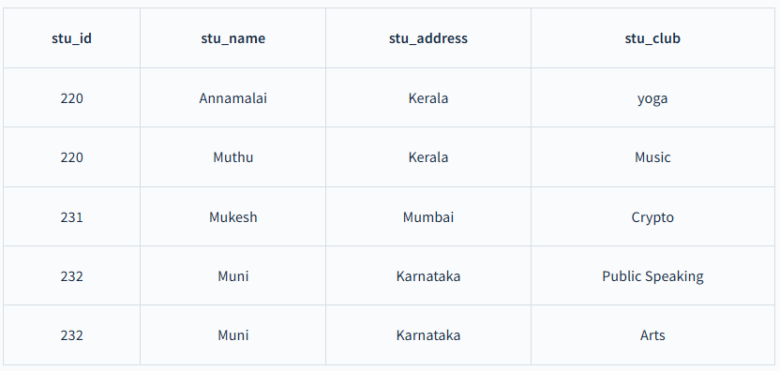
For example, in the above table if a new student named Nanda has joined the college and he has no department affiliation as the club allows intake of students only from second year. Then we can't insert the data of Nanda into the table since the stu_club field cannot accept null values.

Slide 9
2. Update Anomalies
These happen when multiple instances of the same data need to be updated simultaneously to maintain consistency, but not all cases are updated, leading to discrepancies.
Example:
For student Muthu, we have two columns in the above table as he belongs to two clubs at the college. If we want to change Muthu's address, we must update it twice otherwise the data will be inconsistent.
When the correct address gets updated in one club but not in another, Muthu would possess two different addresses, which is not acceptable and could result in inconsistent data.

Slide 10
3. Deletion Anomalies
These arise when the deletion of specific data inadvertently results in the loss of additional, unintended data.
Example: If deleting a student's record also removes information about a course, thereby losing data about other students enrolled in the same course, a deletion anomaly is present.

Slide 11
Removal of Data Anomalies:
Data normalization techniques are employed in database design to remove or minimize data anomalies.
Normalization involves organizing data into multiple related tables to reduce redundancy and dependency.
Normalization
Normalization is a systematic approach to organize data in a database to eliminate redundancy, avoid anomalies and ensure data consistency.
The process involves breaking down large tables into smaller, well-structured ones and defining relationships between them. This not only reduces the chances of storing duplicate data but also improves the overall efficiency of the database.

Slide 12
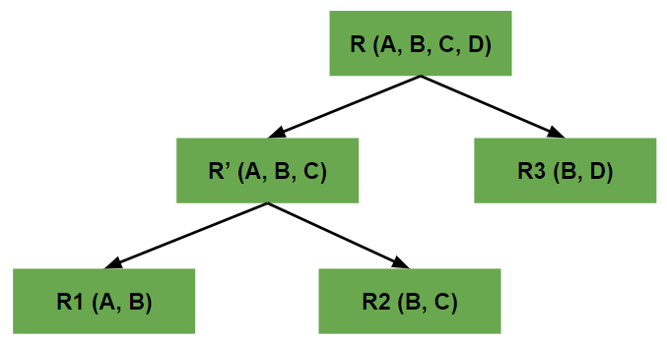
Decomposition In DBMS
Decomposition refers to the division of tables into multiple tables to produce consistency in the data.
When we divide a table into multiple tables or divide a relation into multiple relations, then this process is termed Decomposition in DBMS.
When we perform decomposition in DBMS, we must try to ensure that no information or data is lost.

Slide 13
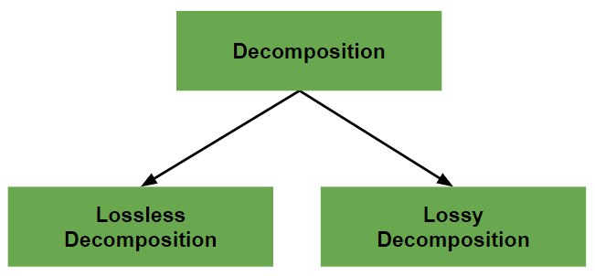
Types of Decomposition
There are two types of Decomposition:
Lossless Decomposition
Lossy Decomposition

Slide 14
1. Lossless Decomposition
A decomposition is said to be lossless when it is feasible to reconstruct the original relation R using joins from the decomposed tables.
It is the most preferred choice. This way, the information will not be lost from the relation when we decompose it.
A lossless join would eventually result in the original relation that is very similar.

Slide 15
We can follow certain rules to ensure that the decomposition is a lossless join decomposition Let’s say we have a relation R and we decomposed it into R1 and R2, then the rules are:
The union of attributes of both the sub relations R1 and R2 must contain all the attributes of original relation R.
R1 ∪ R2 = R
The intersection of attributes of both the sub relations R1 and R2 must not be null, i.e., there should be some attributes that are present in both R1 and R2.
R1 ∩ R2 ≠ ∅
The intersection of attributes of both the sub relations R1 and R2 must be the superkey of R1 or R2, or both R1 and R2.
R1 ∩ R2 = Super key of R1 or R2

Slide 16
2. Lossy Decomposition
Lossy decomposition means when we perform a join operation on the sub-relations it doesn't result in the same relation that was decomposed.
Lossy decomposition is when a relation gets decomposed into multiple relational schemas, in such a way that retrieving the original relation leads to a loss of information.
Thus, a lossy decomposition is bound to lose information.

Slide 17
Properties of Decomposition
Decomposition must have the following properties:
1. Decomposition Must be Lossless
2. Dependency Preservation
3. Lack of Data Redundancy

Slide 18
Dependency Preservation
It says that after decomposing a relation R into R1 and R2, all dependencies of the original relation R must be present either in R1 or R2 or they must be derivable using the combination of functional dependencies present in R1 and R2.
Let’s say:
The original relation R has a set of functional dependencies (FDs) called F. When we decompose R into R1​ and R2​, each gets its own FDs:
f1​: FDs in R1​
f2​: FDs in R2
The combined FDs from R1​ and R2​ are f1∪f2​.

Slide 19
Now, there are three possible cases:
Case 1: f1 ∪ f2 = F
This means the FDs from R1​ and R2​ together exactly match the original FDs F.
Result: The decomposition is dependency-preserving because we haven’t lost any FDs.
Case 2: f1 ∪ f2 ⊂ F
This means some FDs from the original set F are missing in f1∪f2.
Result: The decomposition is not dependency-preserving, as we’ve lost some FDs.
Case 3: f1 ∪ f2 ⊃ F
This means the FDs from R1 and R2 contain extra dependencies that were not part of F.
Result: This case is technically possible but uncommon. These extra dependencies may not cause direct problems but could lead to inconsistencies or unexpected behavior.

Slide 20
Functional Dependency
In relational database management, functional dependency is a concept that specifies the relationship between two sets of attributes where one attribute determines the value of another attribute.
It is denoted as X → Y, where the attribute set on the left side of the arrow, X is called Determinant, and Y is called the Dependent.
“X" is the determinant because it uniquely determines the value of “Y”.
“Y" is the dependent because its value depends on the value of “X“.
It is a constraint that describes how attributes in a table relate to each other.

Slide 21
Example of Functional Dependency Notation
Suppose we have a table with attributes A, B, and C. If attribute A determines the values of attributes B and C, we denote this as:
A → B, C
This notation means that if you know the value of A, you can determine the values of B and C.

Slide 22
Fully Functional Dependency :
If X and Y are an attribute set of a relation, Y is fully functional dependent on X, if Y is functionally dependent on X but not on any proper subset of X.
Example –
In the relation ABC->D, attribute D is fully functionally dependent on ABC and not on any proper subset of ABC. That means that subsets of ABC like AB, BC, A, B, etc cannot determine D.
Partial Functional Dependency :
A functional dependency X->Y is a partial dependency if Y is functionally dependent on X and Y can be determined by any proper subset of X.
For example, we have a relationship AC->B, A->D, and D->B.

Slide 23
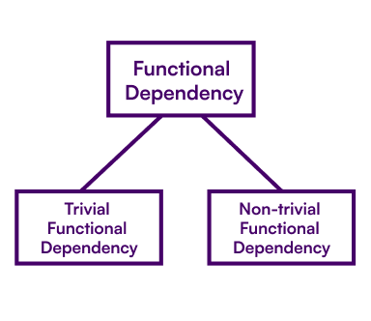
Types of Functional Dependency
The Functional Dependencies are of four major types:
Trivial FD
Non-Trivial FD

Slide 24
Trivial Functional Dependency
In Trivial Functional Dependency, a dependent is always a subset of the determinant. i.e. If X → Y and Y is the subset of X, then it is called trivial functional dependency.
A trivial functional dependency happens when the dependent attribute is already part of the determinant attribute set.
Example: {Roll no., Name} → {Name} is a trivial functional dependency because Name is already part of the determinant (Roll no., Name).

Slide 25
Non-trivial Functional Dependency
If a functional dependency X→Y holds true where Y is not a subset of X then this dependency is called non trivial Functional dependency.
A non-trivial functional dependency occurs when the dependent attribute is not part of the determinant attribute set.
Example: {Roll no., Name} → {Dept name} is a non-trivial functional dependency because Dept name is not part of {Roll no., Name}.

Slide 26
Armstrong’s Axioms in Functional Dependency
Armstrong Axioms
The term Armstrong Axioms refers to the sound and complete set of inference rules or axioms, introduced by William W.
Armstrong, that is used to test the logical implication of functional dependencies.
If F is a set of functional dependencies then the closure of F, denoted as F+, is the set of all functional dependencies logically implied by F.
Armstrong’s Axioms are a set of rules, that when applied repeatedly, generates a closure of functional dependencies.

Slide 27
1. Reflexivity:
Let A be a set of attributes, and B is a subset of A. If B⊆A then A→B.
if B is a subset of A, then A→B.
2. Augmentation:
If A→B is true and Y is an attribute set, then AY→BY is also true. Adding attributes to dependencies does not affect the fundamental dependencies.
If A→B is true, AC→BC is true for any C.
3. Transitivity:
If A→B holds and B→C holds, then A→C also holds

Slide 28
4. Decomposition
If A→BC, then A→B and A→C
5. Composition
If A→B and C→D then AC→BD
6. Union (Notation)
If A→B and A→C then A→BC
7. Pseudo transitivity
If A→B and BC→D then AC→D
8. Self-determination
A→A for any given A.

Slide 29
Closure Of Functional Dependency
The Closure Of Functional Dependency means the complete set of all possible attributes that can be functionally derived from given functional dependency using the inference rules known as Armstrong’s Rules.
If “F” is a functional dependency then closure of functional dependency can be denoted using “{F}+”

Slide 30
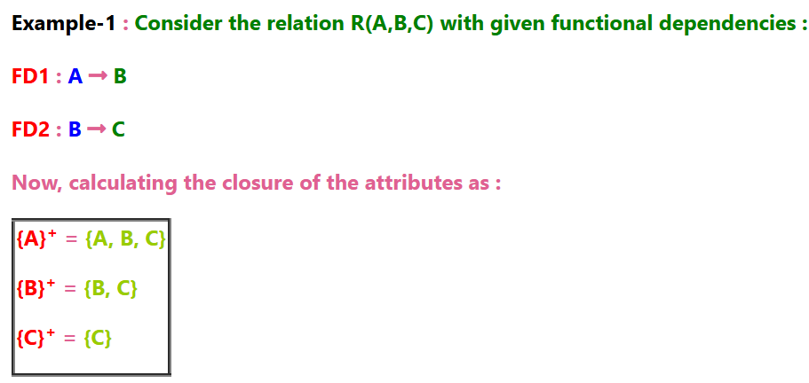

Slide 31
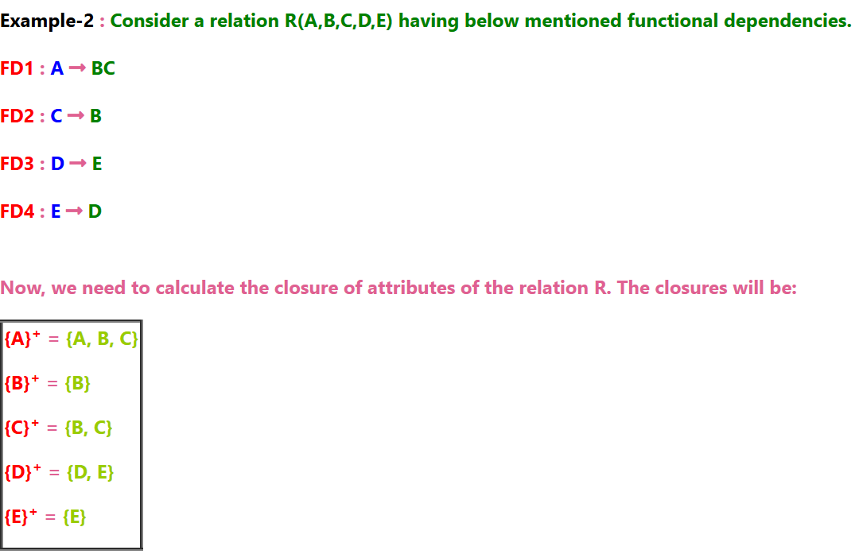
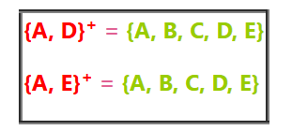

Slide 32
For example given a relation R(A,B,C,D) and FD { A→B, B→C, C→D,D→A}, then
A+=BCDA,
B+=ACDB
C+=ACDB
D+=ACDB

Slide 33
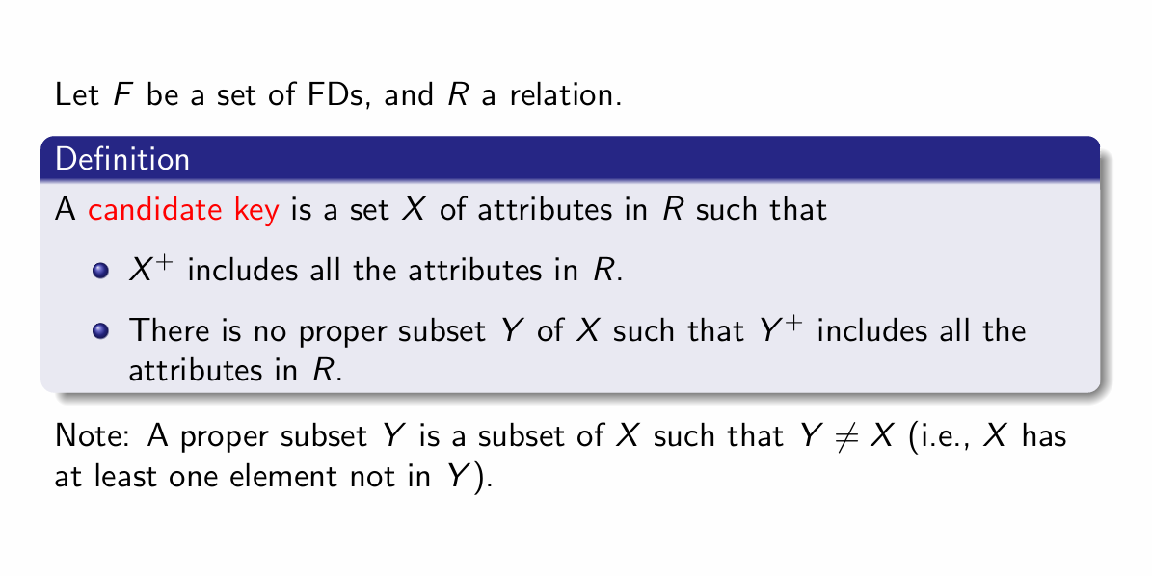

Slide 34
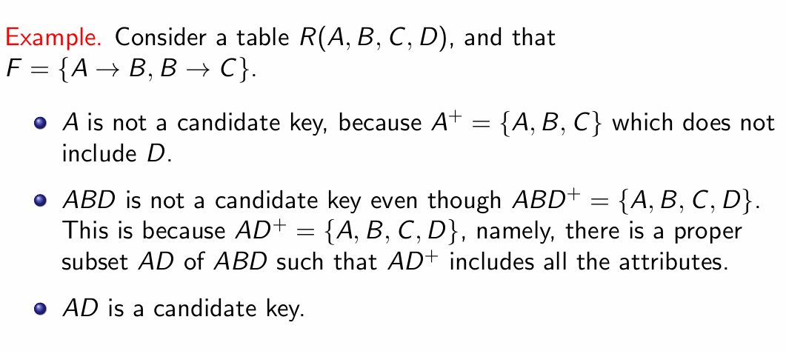

Slide 35
Finding Extraneous Attribute in DBMS
If we can delete an attribute of a functional dependency without modifying the closure of the set of functional dependencies, it is said to be unnecessary.
An extraneous attribute in a functional dependency is an attribute that does not contribute to the closure of attributes on the left-hand side of the dependency.
Removing extraneous attributes helps in simplifying the set of dependencies without changing its meaning.
If we are able to remove an attribute from a functional dependency without changing the closure of the set of functional dependencies, that attribute is called as Extraneous Attribute.

Slide 36
Example 1:
Let us consider a relation R with schema R(A, B, C) and set of functional dependencies F = { AB → C, A → C }. The closure for F is F+ = { AB → C, A → C }.
In AB → C, B is an extraneous attribute. The reason is, there is another FD A → C, which means when A alone can determine C, the use of B is unnecessary (redundant).
Example 2:
If you have F = {A -> C, AB -> CD} and you find that AB -> C is implied by A -> C, then C in the second dependency (AB->CD) is extraneous, since it is also derived by A -> C.

Slide 37
Canonical Cover
Irreducible functional relationships or a canonical cover FD is a reduced version of FD with a comparable closure to the original FD set.
A canonical cover of a set of functional dependencies is the minimal set of dependencies that logically implies all the dependencies in the original set.
It helps in simplifying the set of functional dependencies while preserving the same closure of attributes.

Slide 38
How to Find Canonical Cover
Following is an Algorithm to determine the Canonical cover of set F:
Replace any dependencies in ɑ1→β1 and ɑ1→β2 with ɑ1→β1β2 using the union rule.
With an extraneous attribute, either in ɑ or β find a functional dependency ɑ→β.
Delete any extraneous attribute found in ɑ→β.
until F does not change.

Slide 39
Example: Given a relational Schema R( A, B, C, D) and set of Function Dependency FD = { B → A, AD → BC, C → ABD }. Find the canonical cover?
Solution: Given FD = { B → A, AD → BC, C → ABD }, now decompose the FD using decomposition rule( Armstrong Axiom ).
B → A
AD → B ( using decomposition inference rule on AD → BC)
AD → C ( using decomposition inference rule on AD → BC)
C → A ( using decomposition inference rule on C → ABD)
C → B ( using decomposition inference rule on C → ABD)
C → D ( using decomposition inference rule on C → ABD)
Now set of FD = { B → A, AD → B, AD → C, C → A, C → B, C → D }
The next step is to find closure of the left side of each of the given FD by including that FD and excluding that FD, if closure in both cases are same then that FD is redundant and we remove that FD from the given set, otherwise if both the closures are different then we do not exclude that FD.

Slide 40
Calculating closure of all FD { B → A, AD → B, AD → C, C → A, C → B, C → D }
FD: B → A is important and cannot be removed from the set of FD.
FD AD → B is not important and can be removed from the set of FD.
Hence resultant FD = { B → A, AD → C, C → A, C → B, C → D }
FD C → A is not important and can be removed from the set of FD.
Hence resultant FD = { B → A, AD → C, C → B, C → D }
we can rewrite as
FD = { B → A, AD → C, C → BD } is Canonical Cover

Slide 41
Example 2: Given a relational Schema R( W, X, Y, Z) and set of Function Dependency FD = { W → X, Y → X, Z → WXY, WY → Z }. Find the canonical cover?
Solution:
FD = { W → X, Y → X, Z → WY, WY → Z } is Canonical Cover

Slide 42
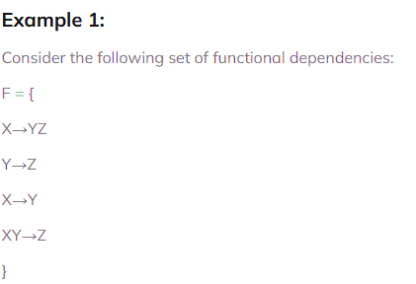
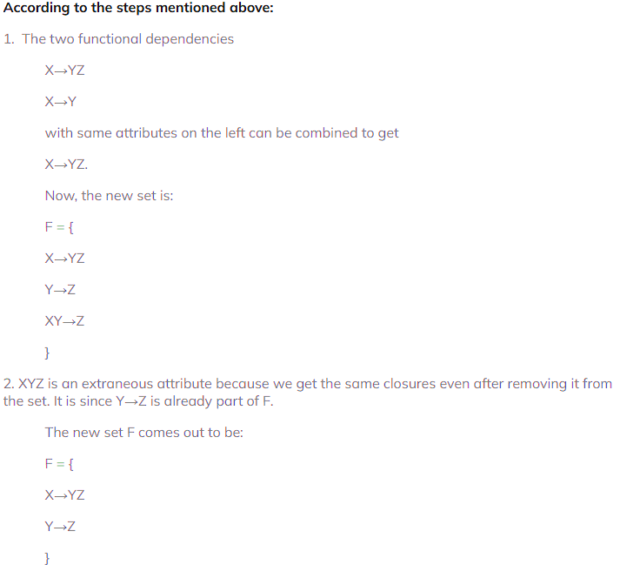

Slide 43
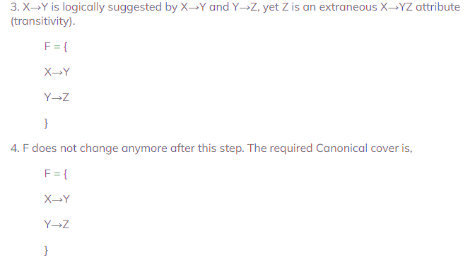

Slide 44
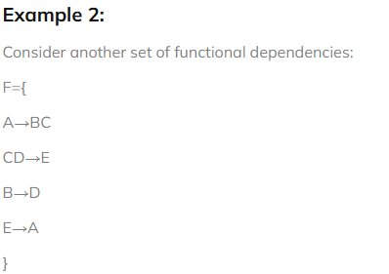

Slide 45
Normalization
Normalization is a systematic approach to organize data in a database to eliminate redundancy, avoid anomalies and ensure data consistency.
The process involves breaking down large tables into smaller, well-structured ones and defining relationships between them.
This not only reduces the chances of storing duplicate data but also improves the overall efficiency of the database.
Purpose of Normal Forms:
To organize data efficiently, eliminate redundancy, and prevent anomalies during data operations like insertion, deletion and updates.

Slide 46
Advantages of Normal Form
Reduced data redundancy: Normalization helps to eliminate duplicate data in tables, reducing the amount of storage space needed and improving database efficiency.
Improved data consistency: Normalization ensures that data is stored in a consistent and organized manner, reducing the risk of data inconsistencies and errors.
Simplified database design: Normalization provides guidelines for organizing tables and data relationships, making it easier to design and maintain a database.
Improved query performance: Normalized tables are typically easier to search and retrieve data from, resulting in faster query performance.
Easier database maintenance: Normalization reduces the complexity of a database by breaking it down into smaller, more manageable tables, making it easier to add, modify, and delete data.

Slide 47
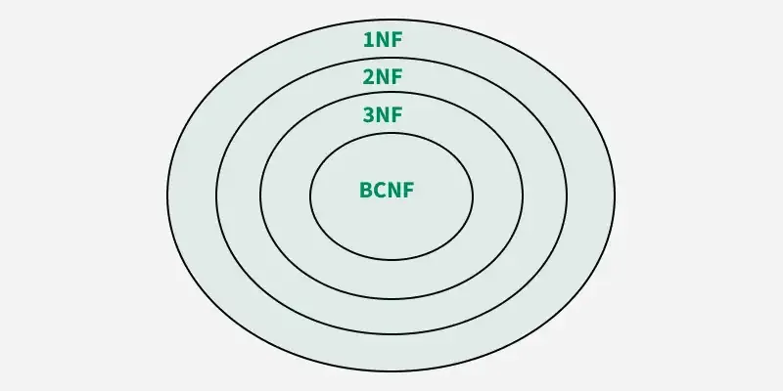

Slide 48
Types of DBMS Normal forms
Normalization rules are divided into the following normal forms:
First Normal Form
Second Normal Form
Third Normal Form
BCNF
Fourth Normal Form
Fifth Normal Form

Slide 49
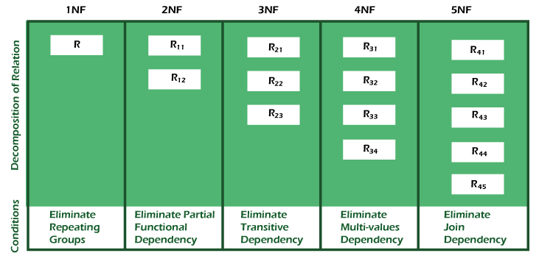

Slide 50
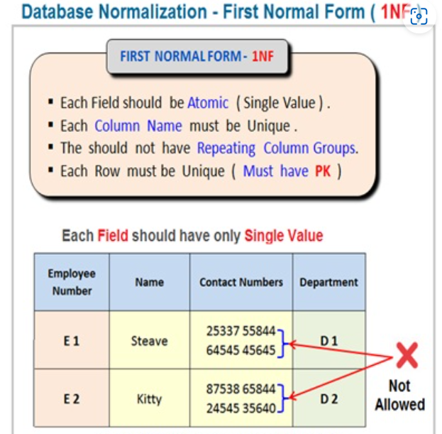
First Normal Form (1NF)
A relation will be 1NF if it contains an atomic value.
It states that an attribute of a table cannot hold multiple values. It must hold only single-valued attribute.

Slide 51
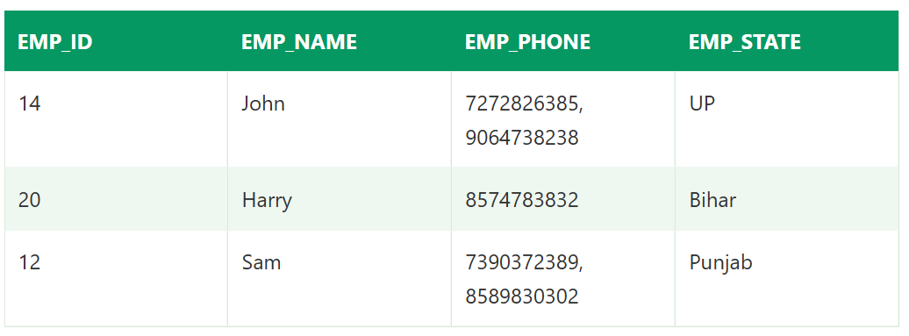
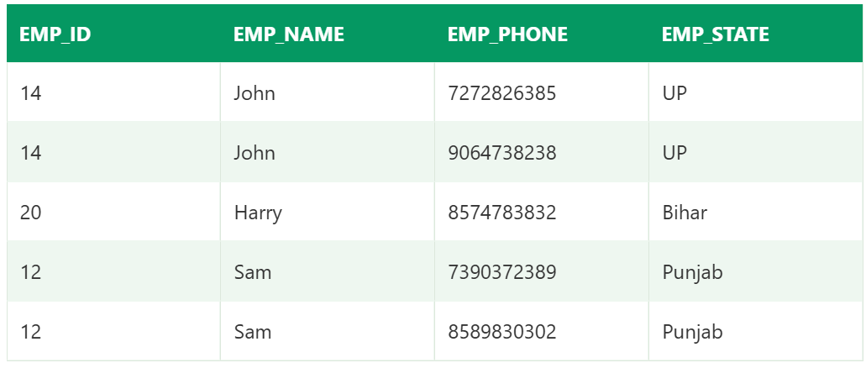

Slide 52
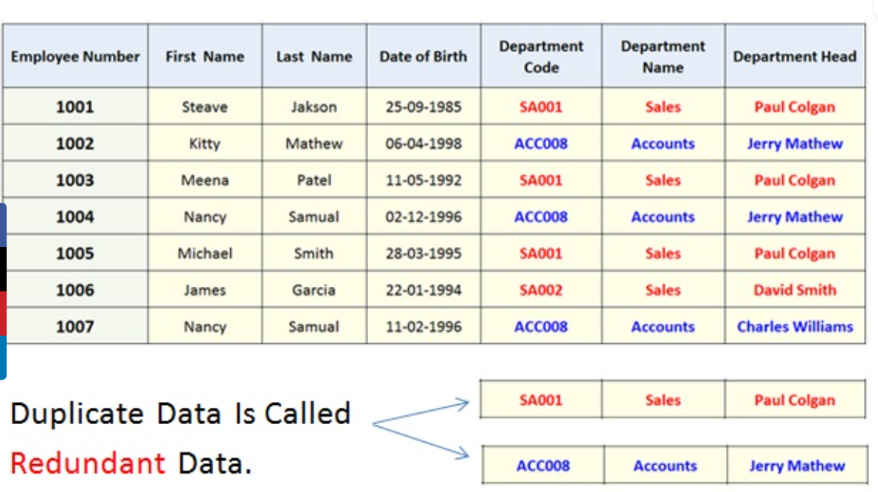
Using the First Normal Form, data redundancy increases, as there will be many columns with same data in multiple rows but each row as a whole will be unique.

Slide 53
Second Normal Form (2NF)
In the 2NF, relational must be in 1NF.
The table should not possess partial dependency.
The partial dependency here means the proper subset of the candidate key should give a non-prime attribute.(part of candidate key non prime attribute)
In the second normal form, all non-key attributes are fully functional dependent on the primary key.

Slide 54
What is Prime Attribute and Non-Prime Attribute?
Attributes that form a candidate key of a relation are called prime attributes (i.e., attributes which are part of any candidate key is called prime attribute). The rest of the attributes of the relation are non-prime.
A non-prime attribute is an attribute within a table that is not part of the primary key and does not contribute to the unique identification of rows.
Non-prime attributes are those attributes of the relationships that are not present in any of the possible candidate keys of the relation. They are also known as non-key attributes.

Slide 55
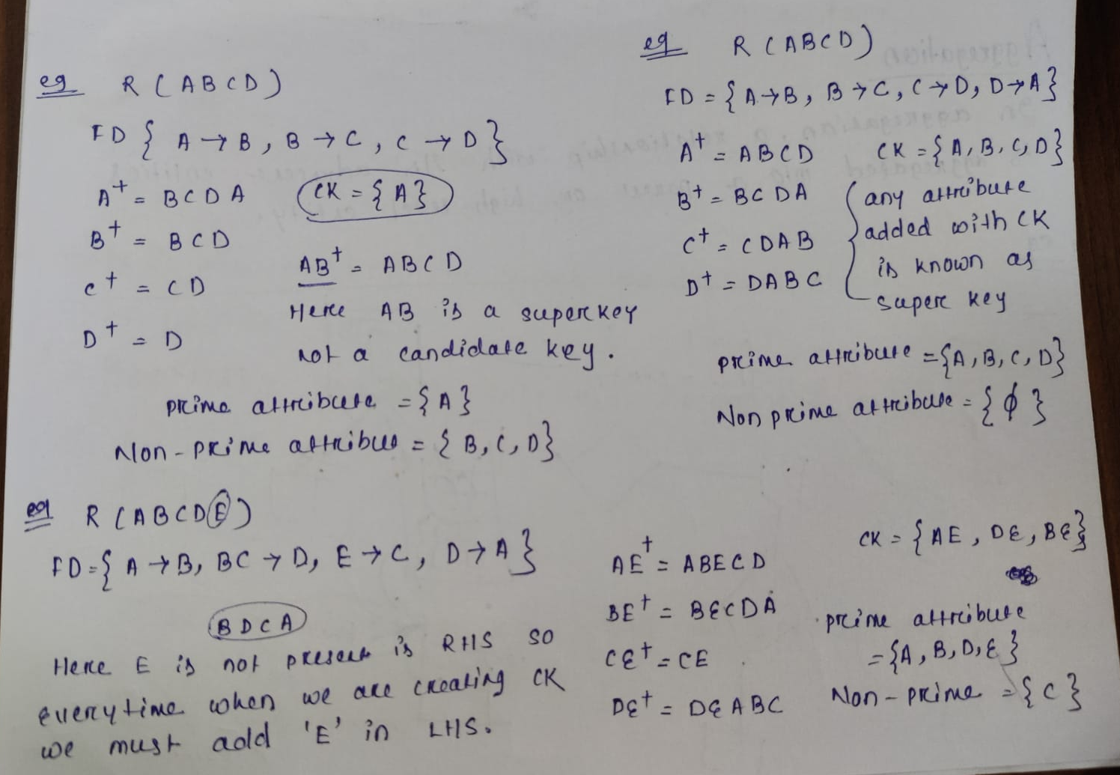

Slide 56
To make sure that a table follows the rules of 2NF, you need to:
Identify All Candidate Keys:
Determine Functional Dependencies:
Eliminate Partial Dependencies:
For each partial dependency:
Move the dependent attributes into a new table along with the part of the key they depend on.
Ensure the new table has a unique primary key.
Repeat Until No Partial Dependencies Remain

Slide 57
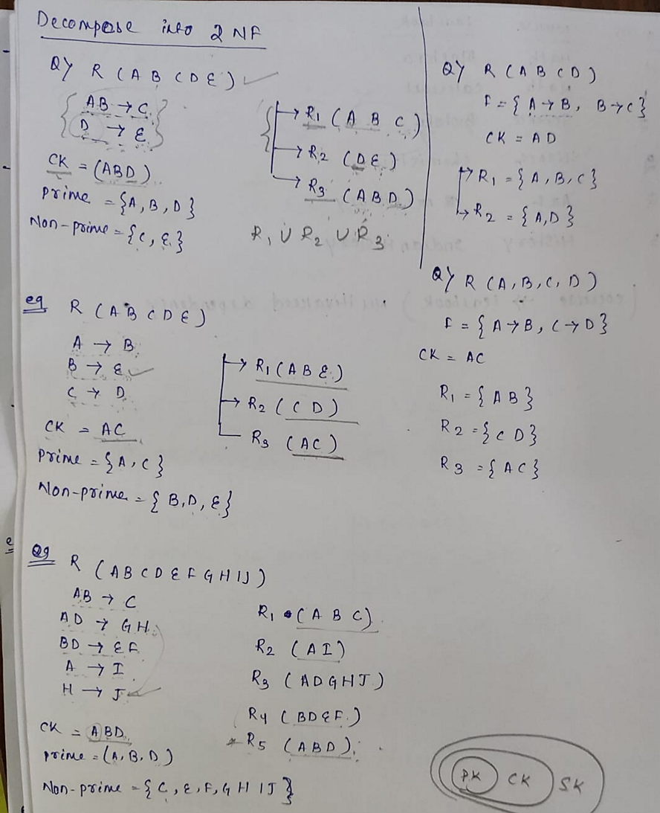
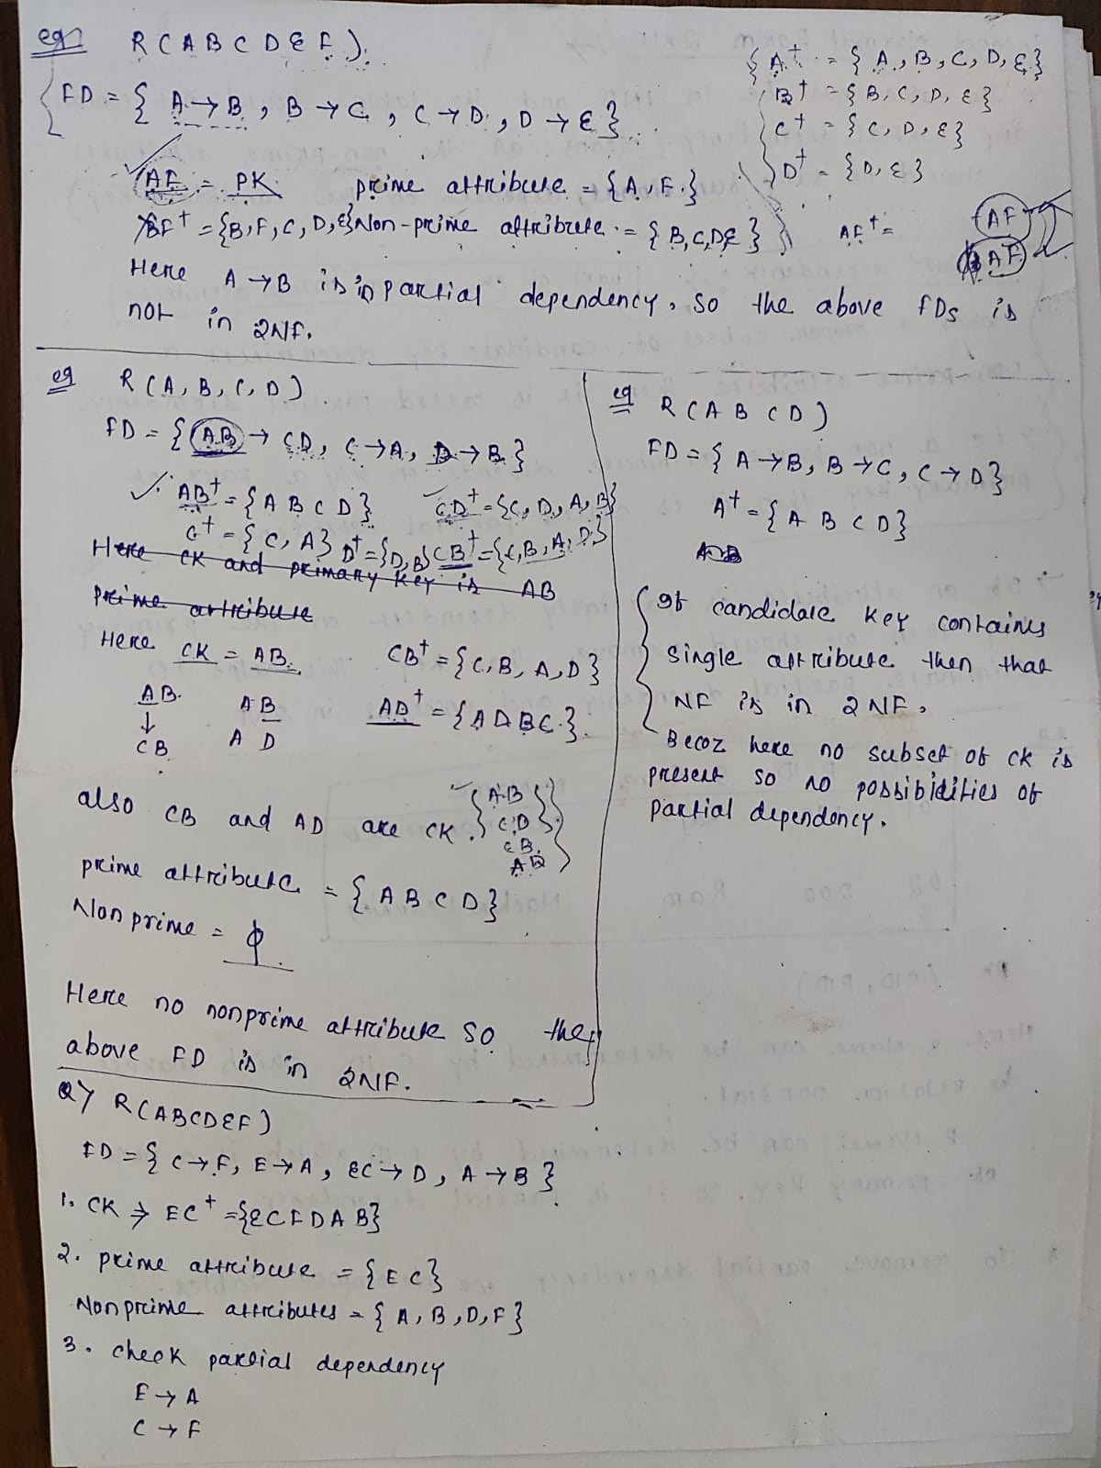

Slide 58
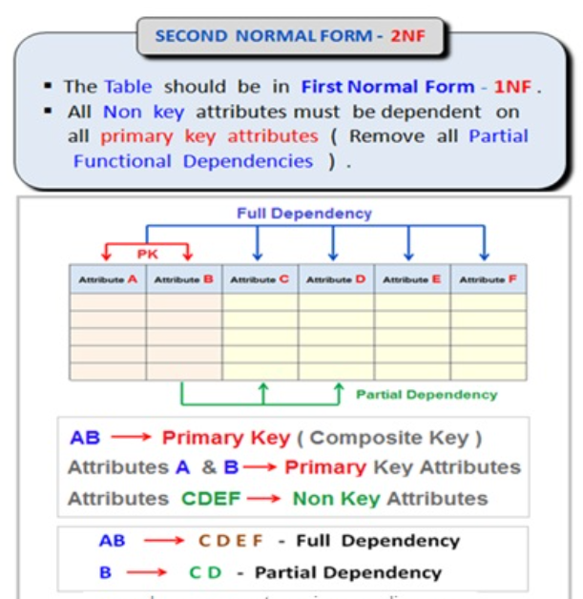

Slide 59
Third Normal Form (3NF)
A relation will be in 3NF if it is in 2NF.
It does not contain any transitive partial dependency.
3NF is used to reduce the data duplication. It is also used to achieve the data integrity.
If there is no transitive dependency for non-prime attributes, then the relation must be in third normal form.

Slide 60
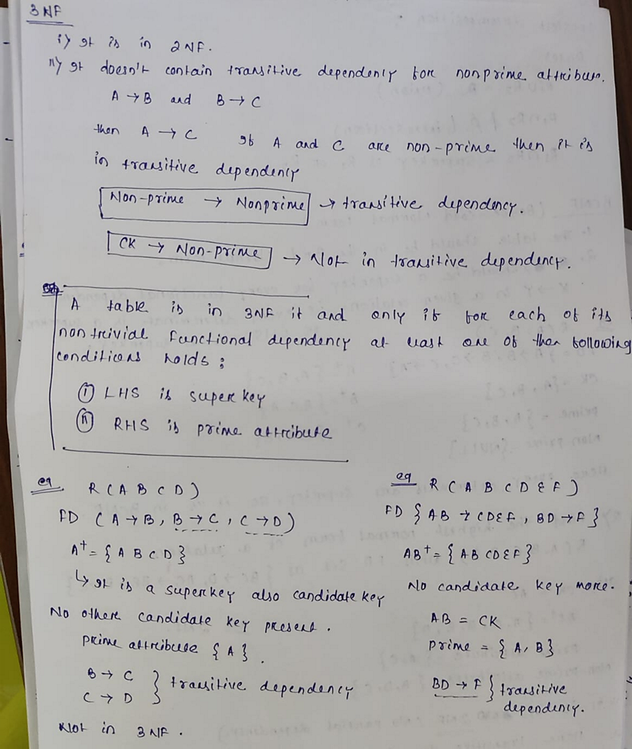
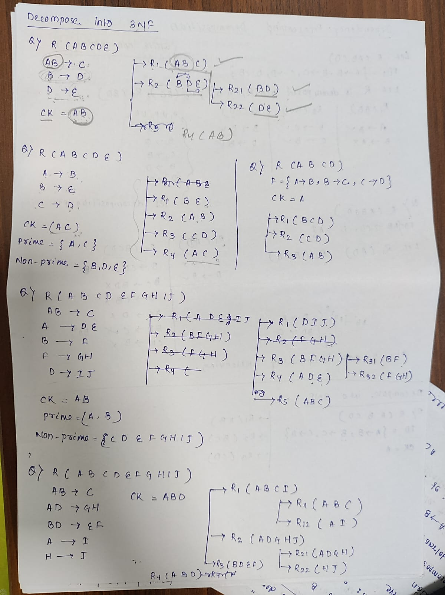

Slide 61
